Slide 1
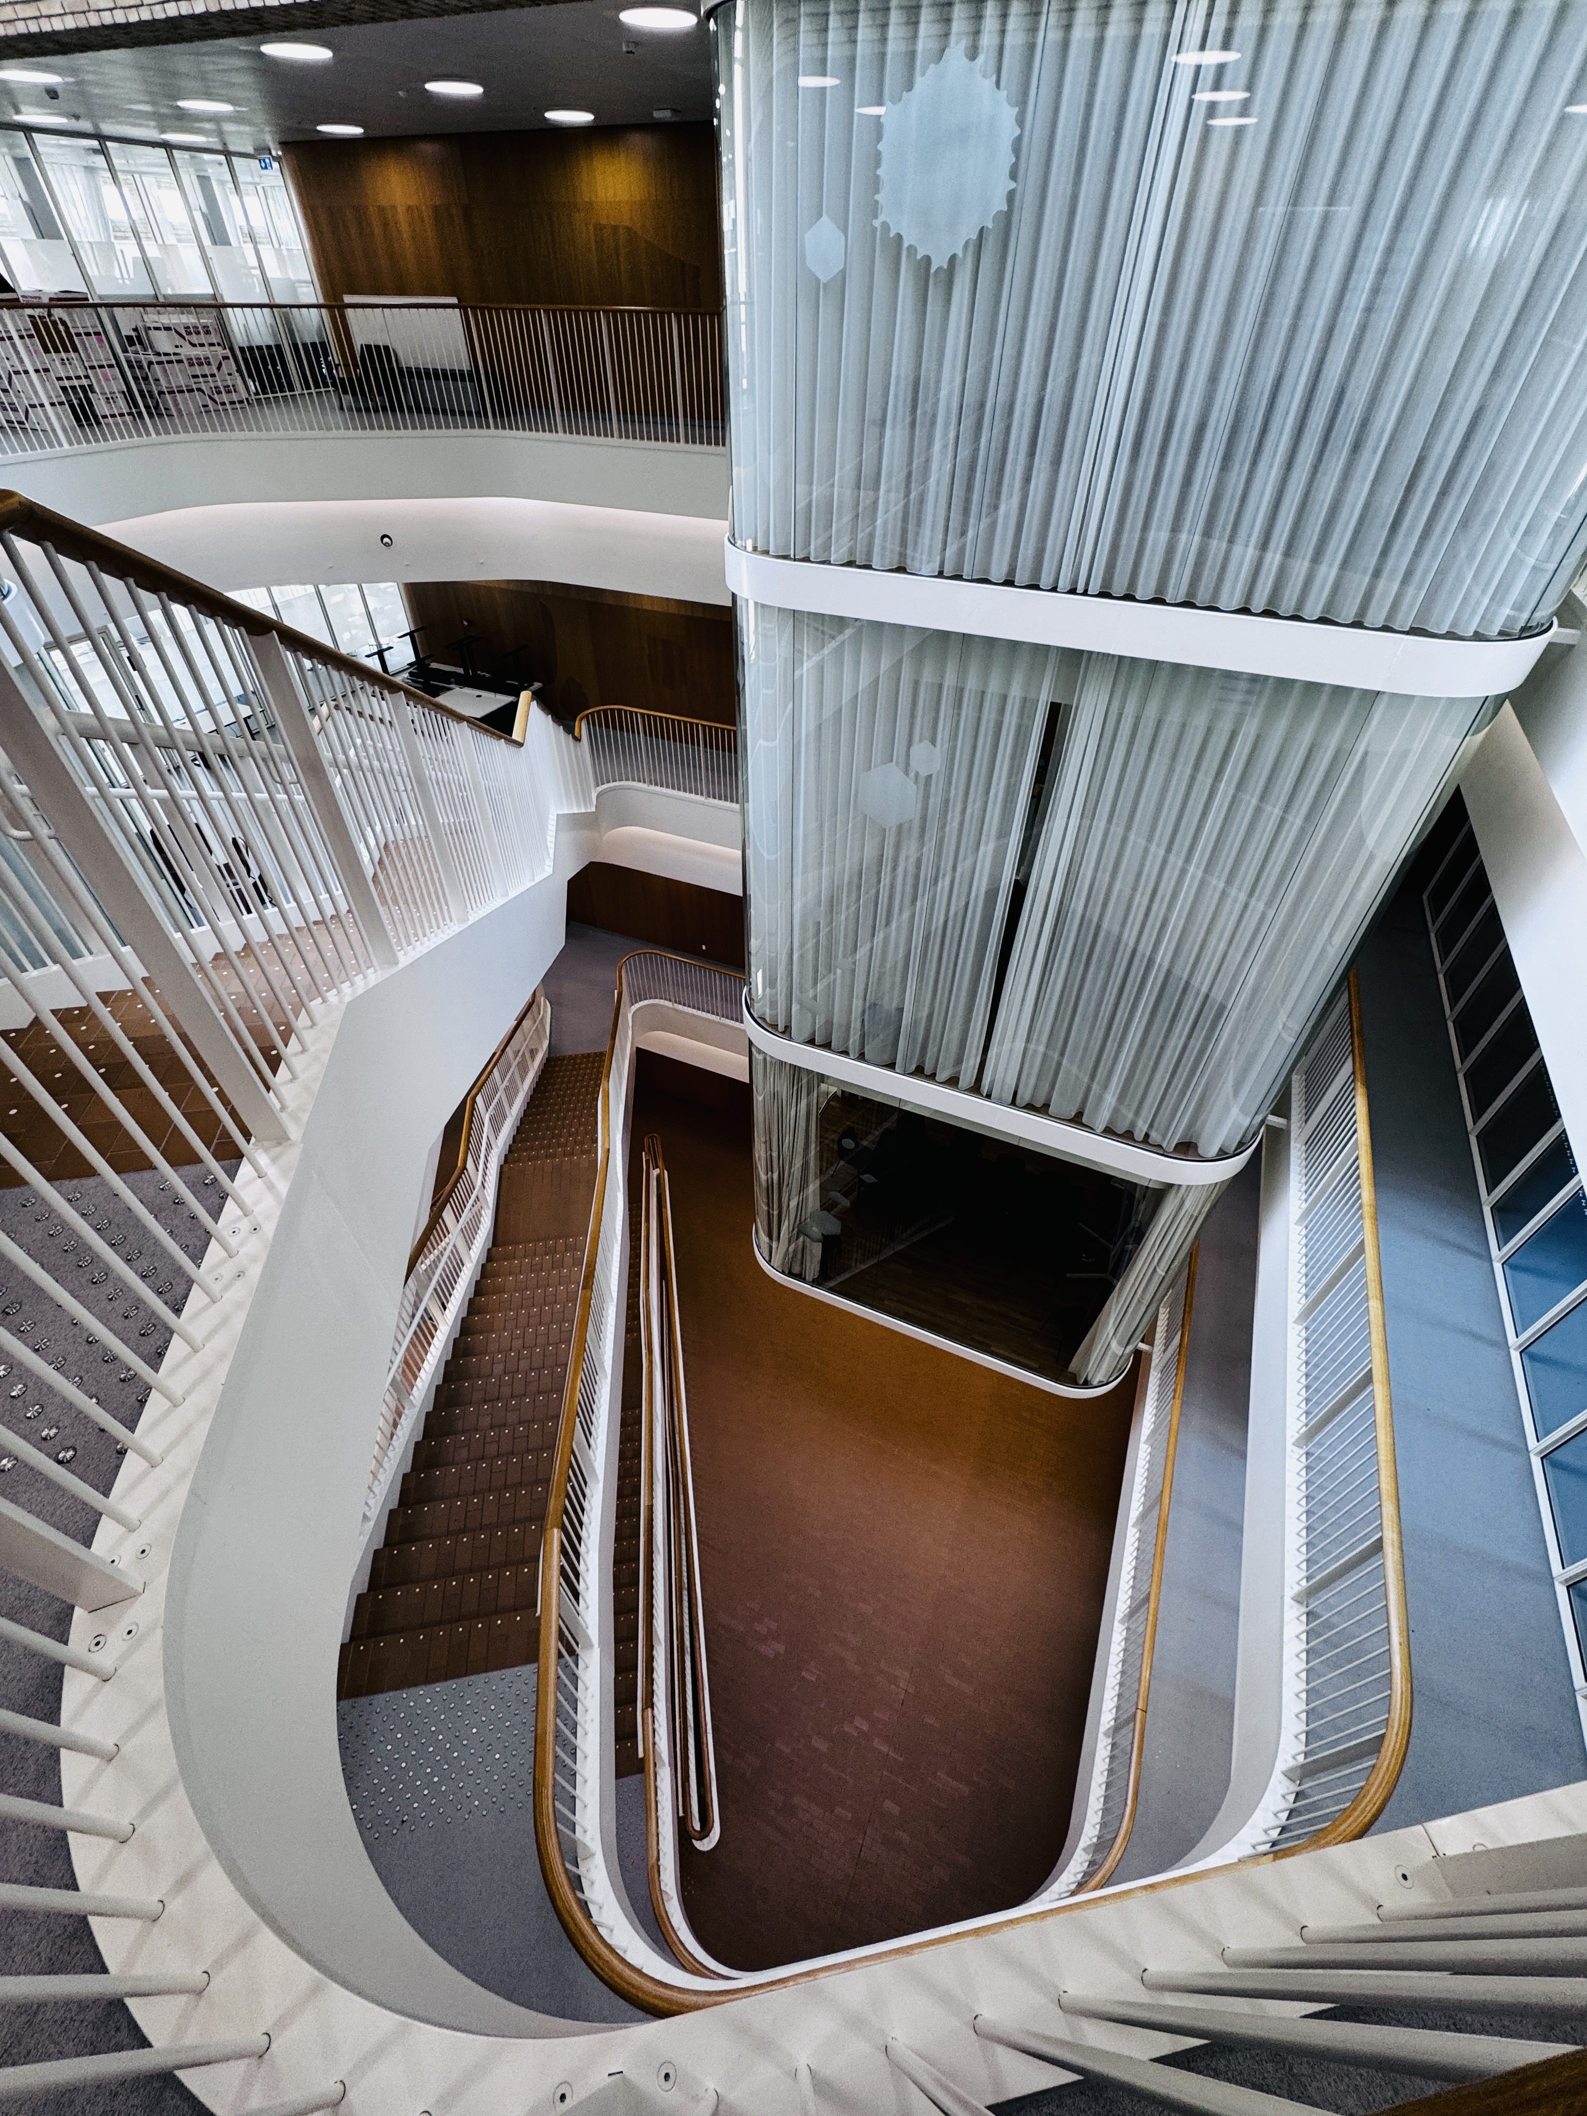
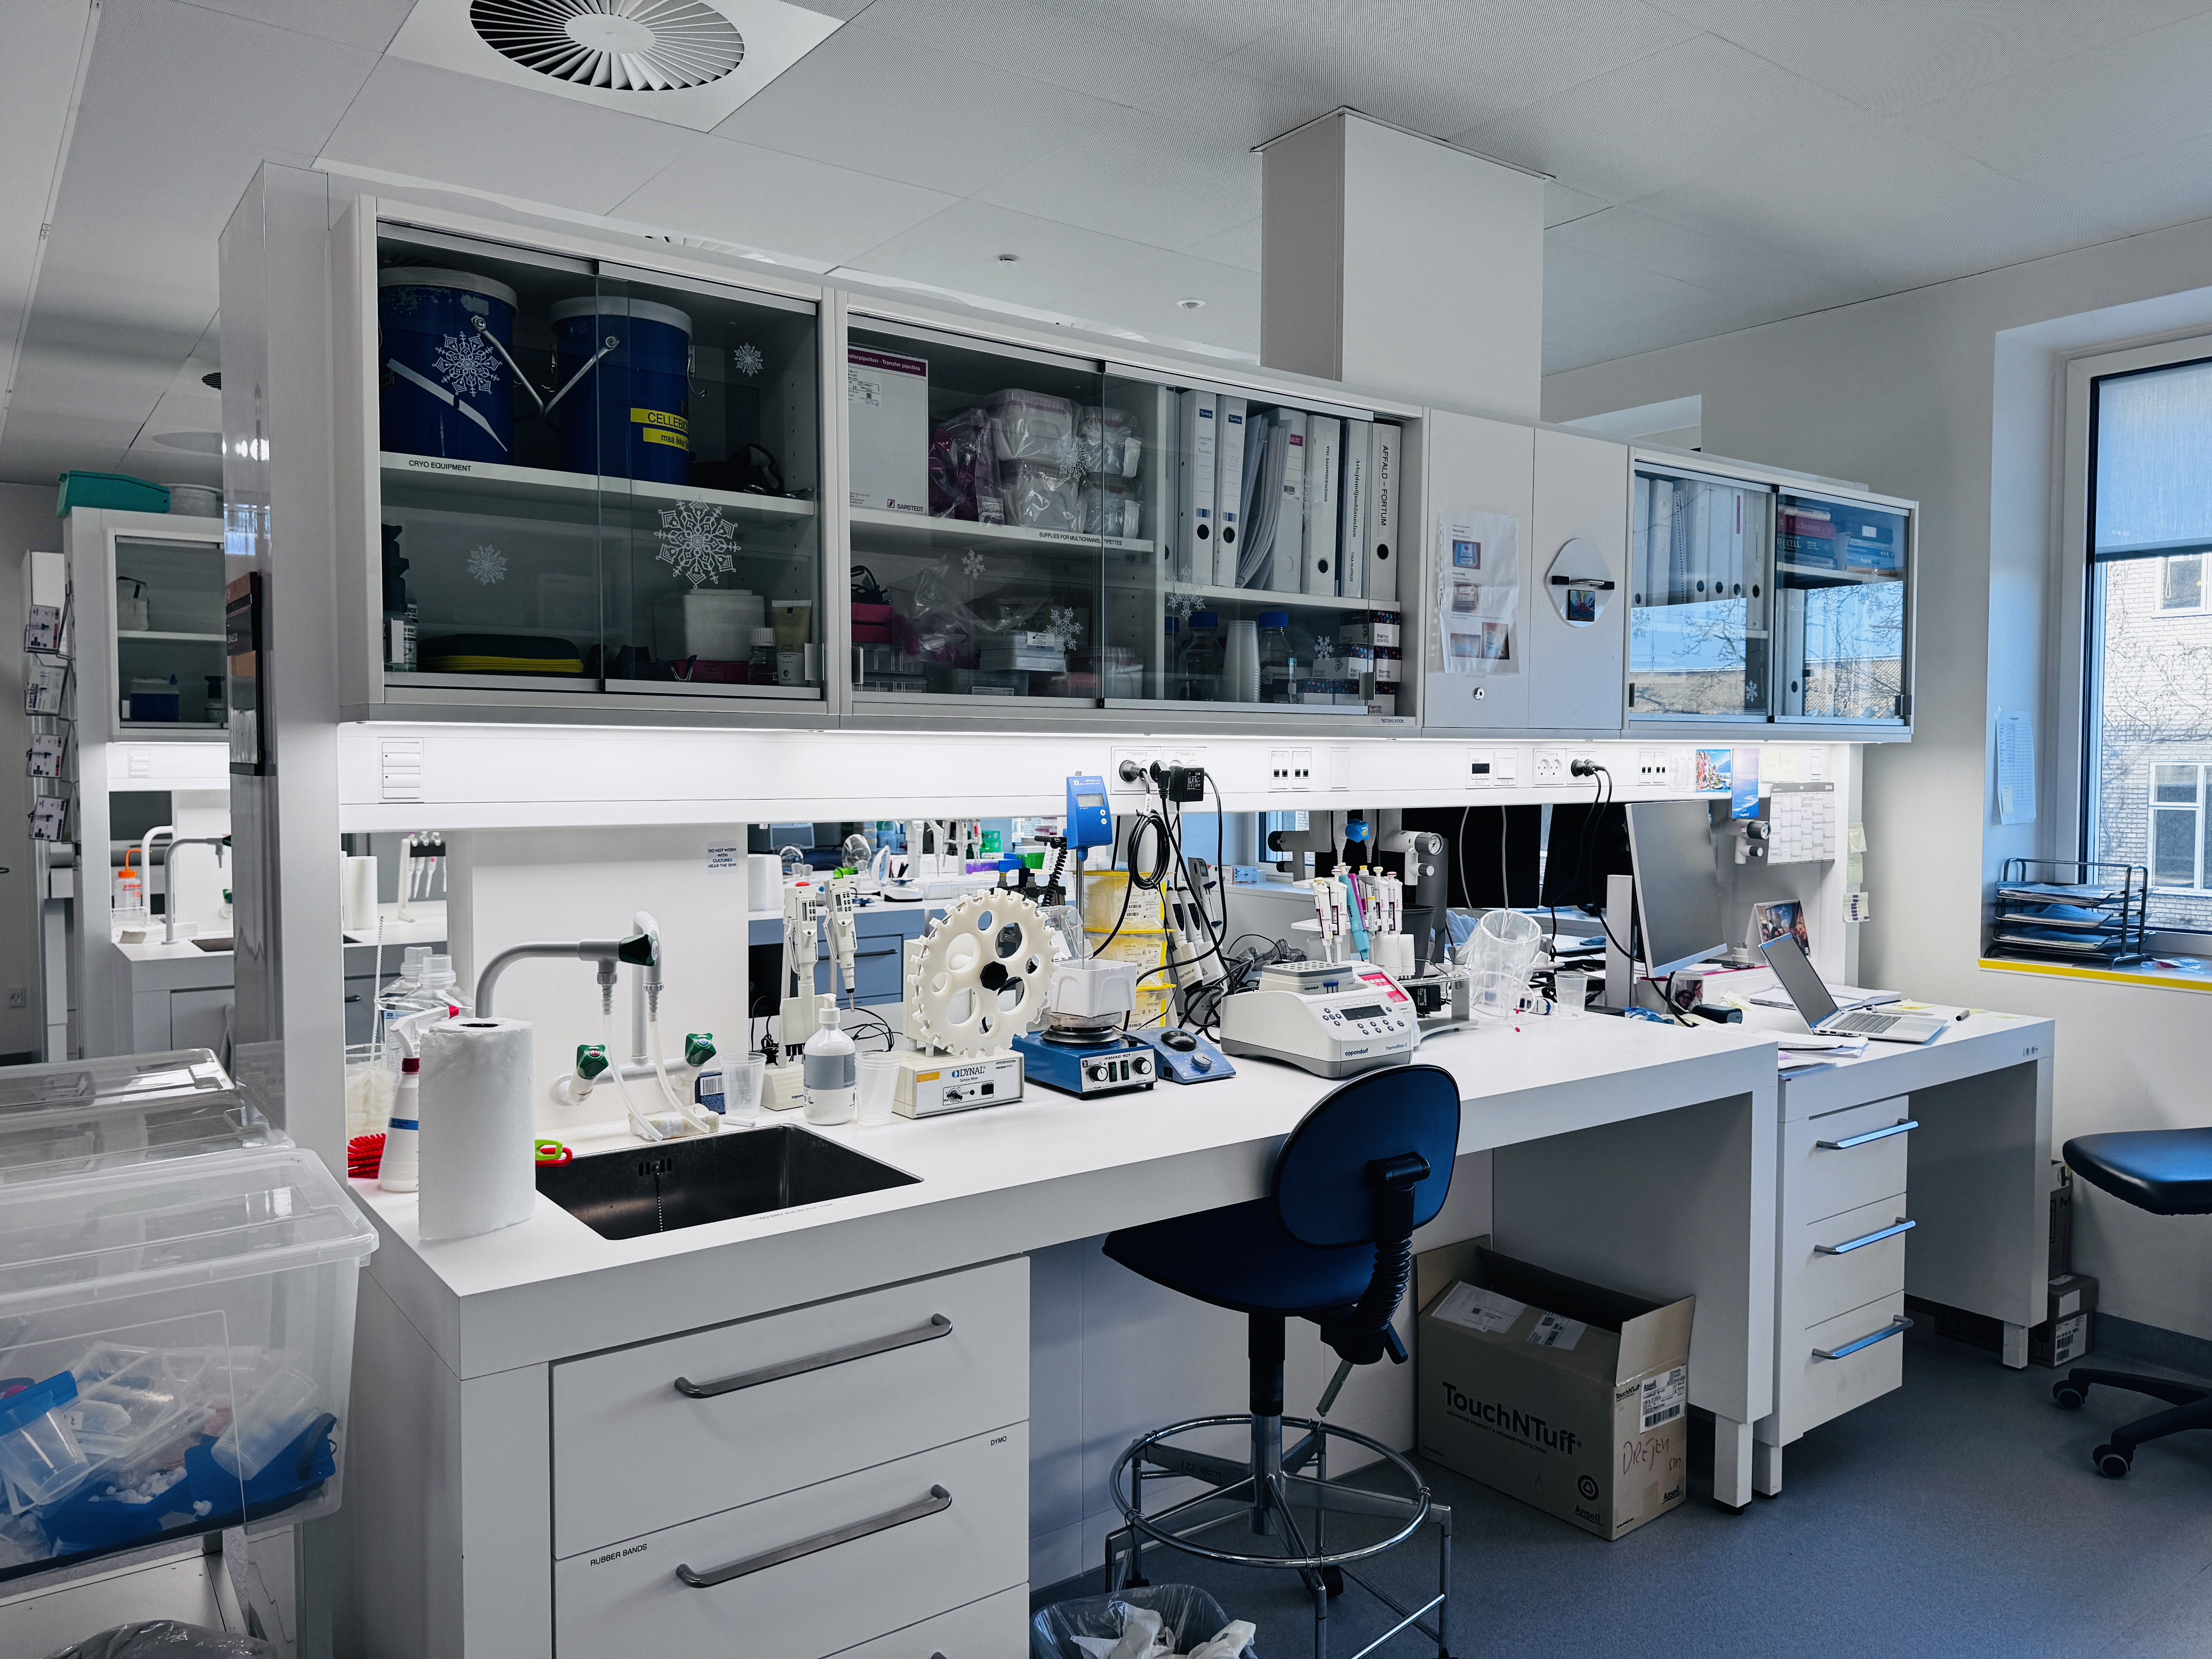
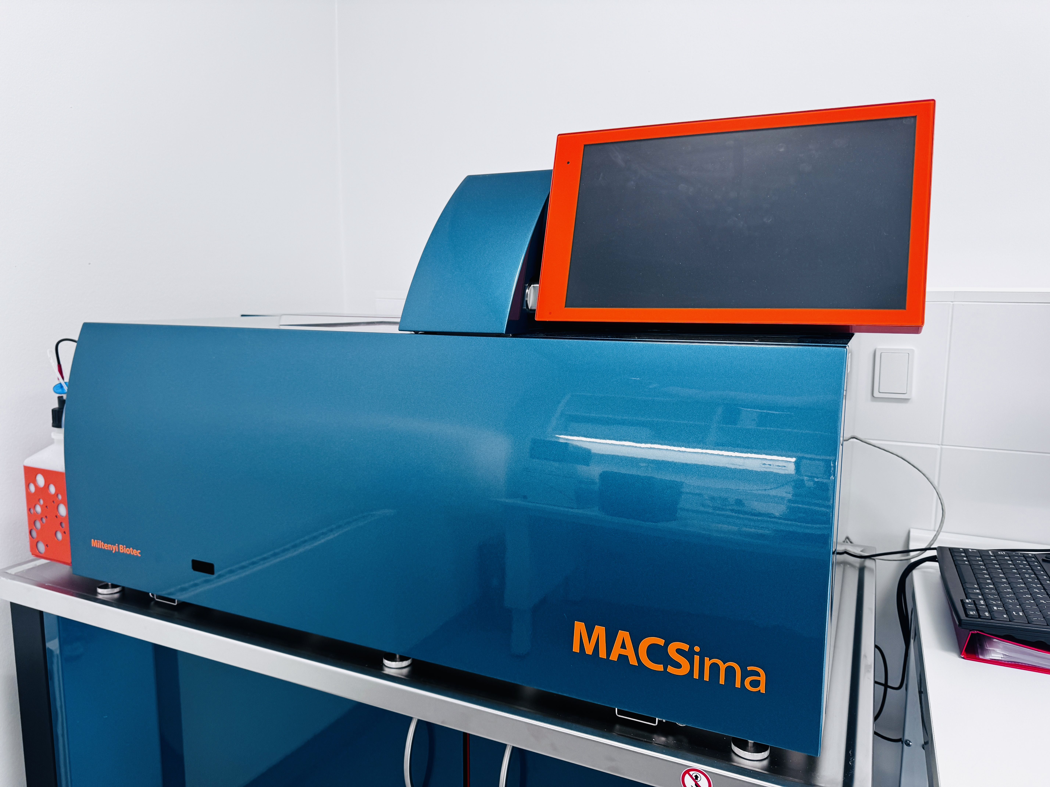
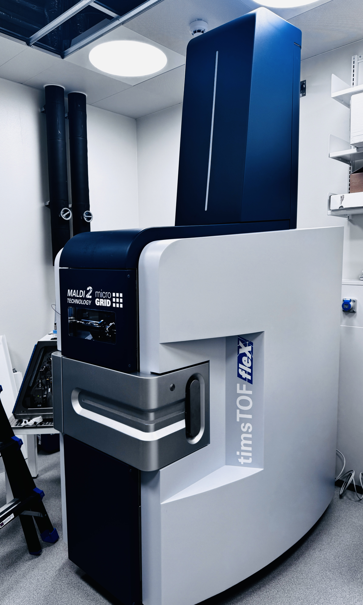
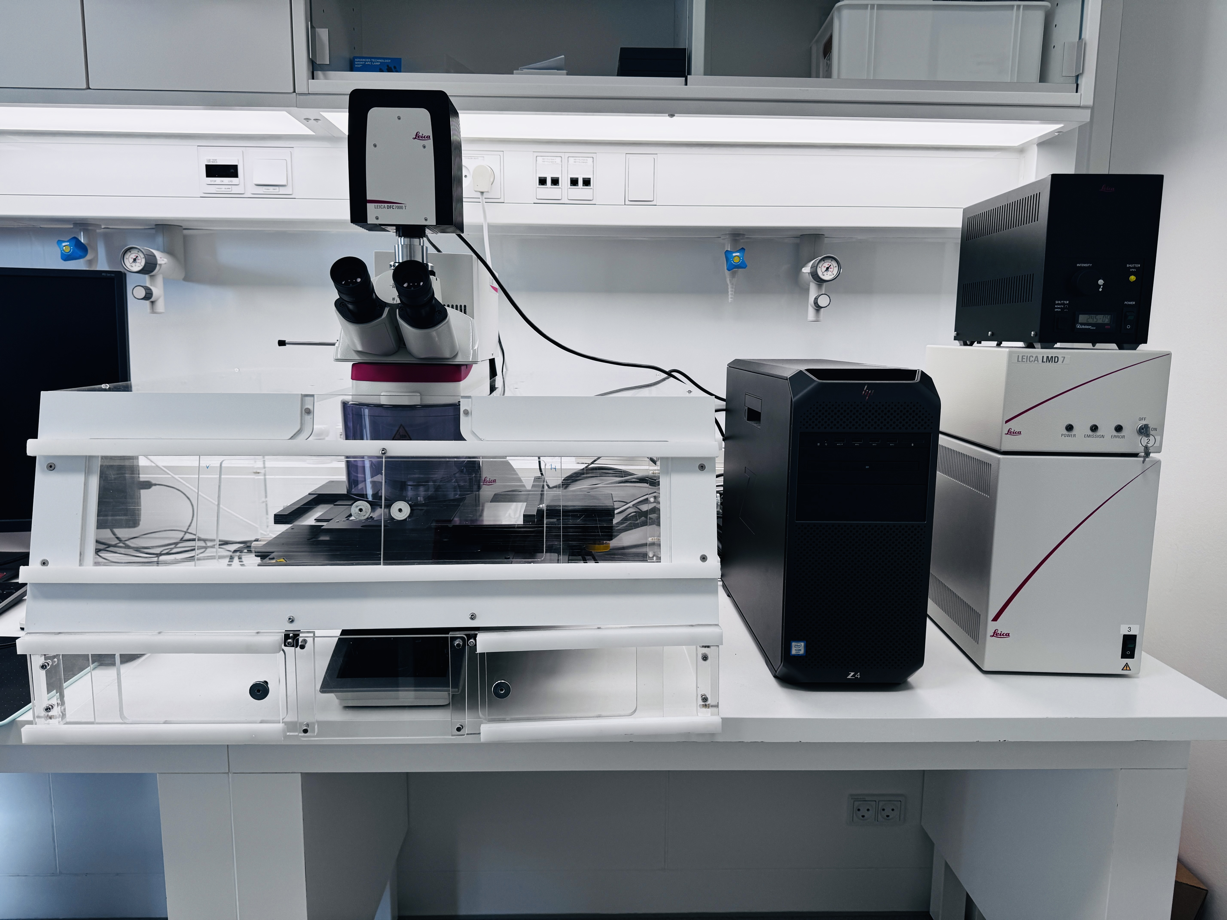
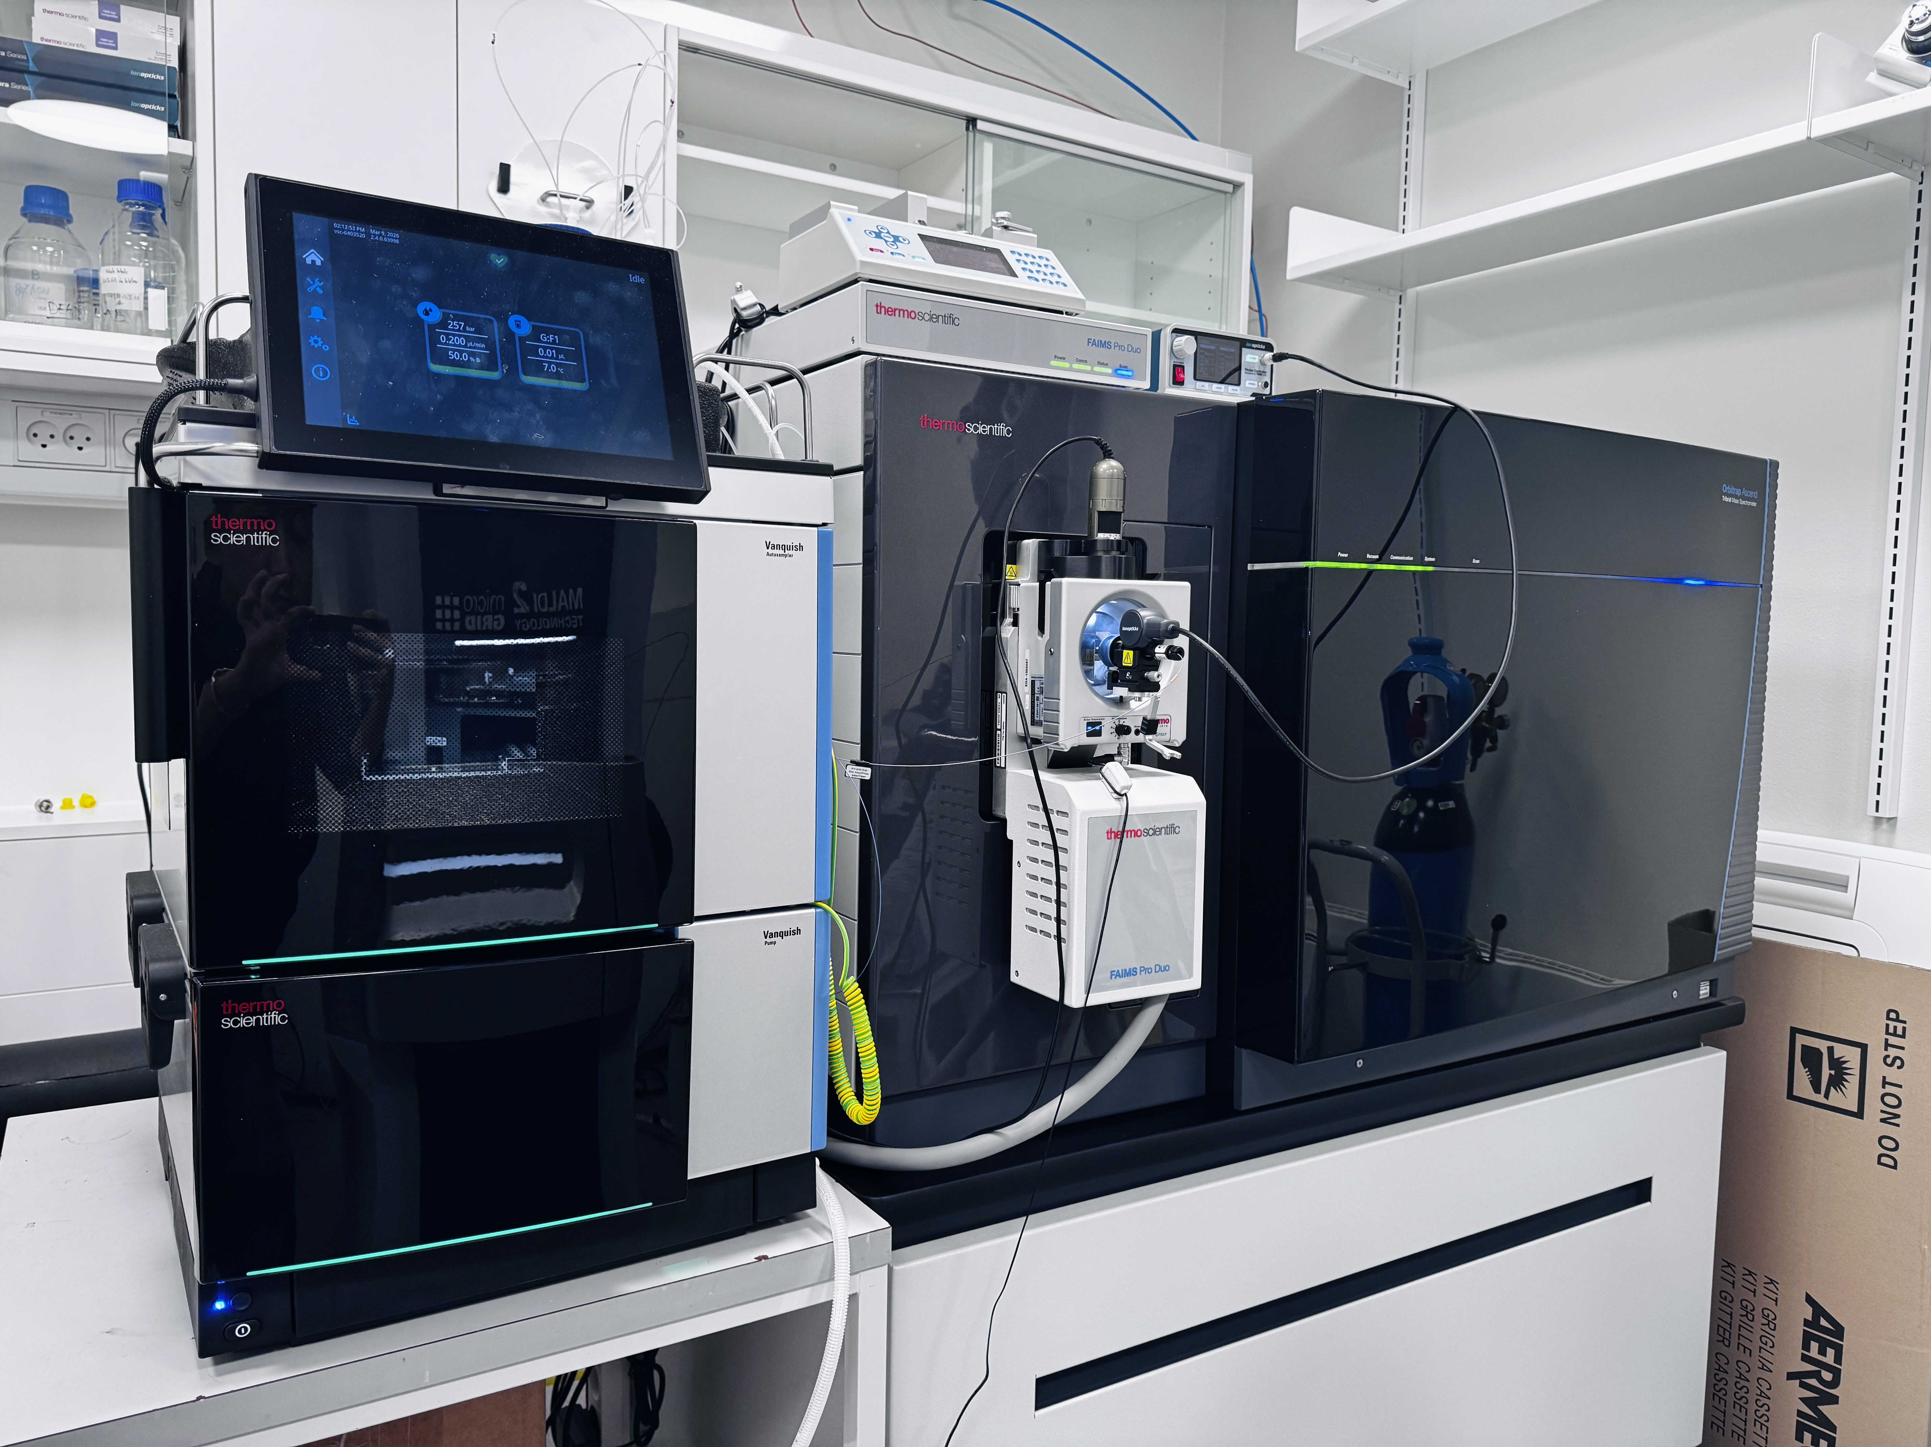


Lab space
Automated multiplexing (MACSima)
Spatial metabolomics
(timsTOF fleX MALDI-2)
The Skou Building (Main Hub)
Laser microdissection (LMD7)
Mass spectrometry (OrbitrapAscend)

